Slide 1

Assessment with LON-CAPA
May 6th, 2010
Purdue University
Gerd Kortemeyer
Michigan State University
http://physics.lite.msu.edu/
Username: Your “Alias”
Password: purdue
Select: LB 272 – Intro Physics …

Slide 2
Assessment
Assessment: Feedback to learners and instructors
Formative assessment:
  Students can keep track of their own learning
    Students do not fall behind
  Instructors keep track of their students’ learning
    can adapt the teaching to the learning
Summative assessment: exams
  Technology allows for frequent exams

Slide 3
Overview
Pre-Class Questions
  Students being prepared for lecture
  Just-In-Time Teaching
In-Class Questions
  Clickers
Post-Class Questions
  Homework
  Online Discussions, Helprooms
  Exams
Does this even work?
How is this realistically possible?
Write some questions
Lecture
?

Slide 4
Pre-Class Questions
Students being prepared for lecture
Just-In-Time Teaching

Slide 5
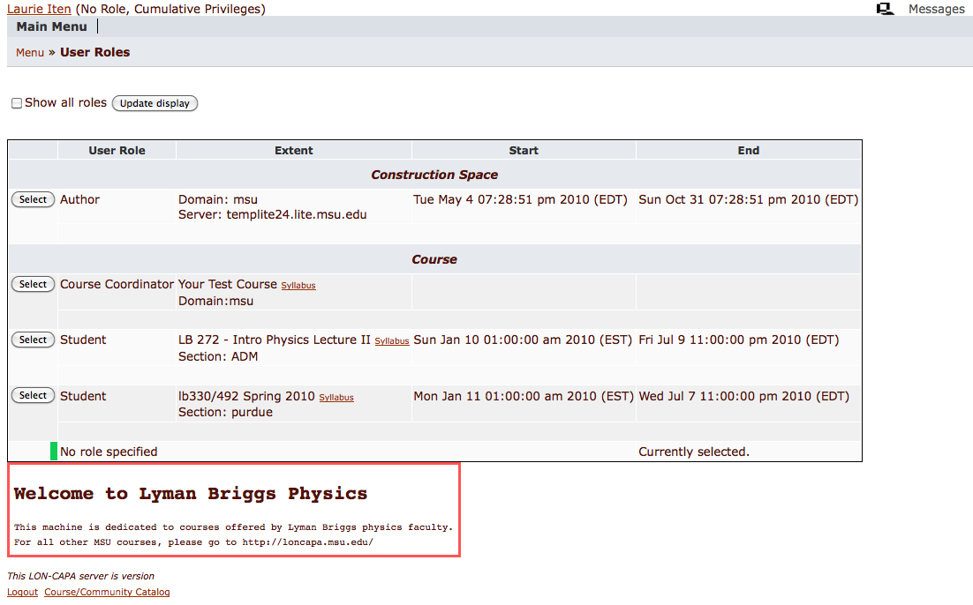
Pre-Class Questions
http://physics.lite.msu.edu/
Username: Your “Alias”
Password: purdue
Select: LB 272 – Intro Physics …

Slide 6
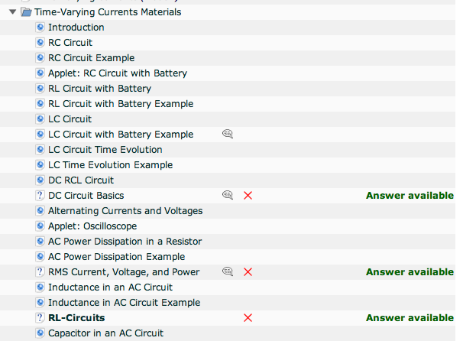
Pre-Class Questions
Easy questions embedded into content
Due before lecture

Slide 7
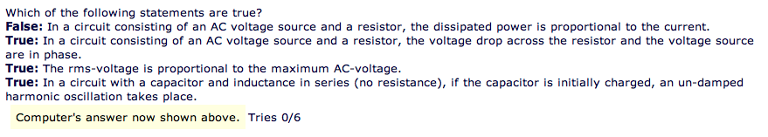
Pre-Class Questions
Make sure students read materials
Questions can be answered just based on the readings
Students come prepared

Slide 8
Just-In-Time
Adapt lecture to student difficulties
When I looked at your homework this morning, I saw that all of you have understood quantum field theory, but many of you still have problems with long division. So this morning, we will …

Slide 9
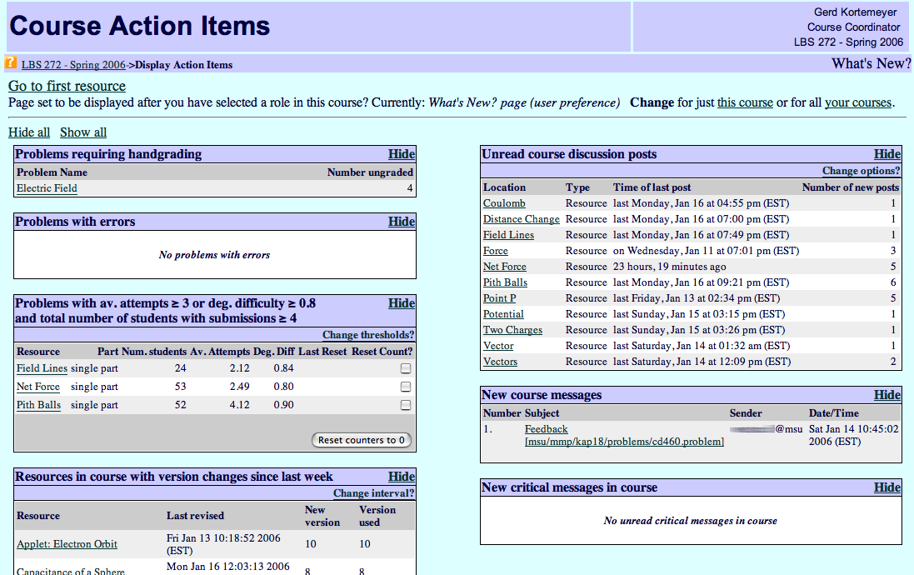
Just-In-Time
Discussions
Difficult problems

Slide 10
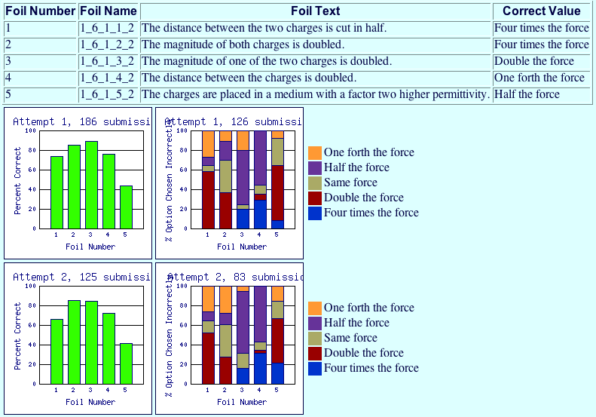
Just-In-Time

Slide 11
In-Class Questions
Clickers

Slide 12
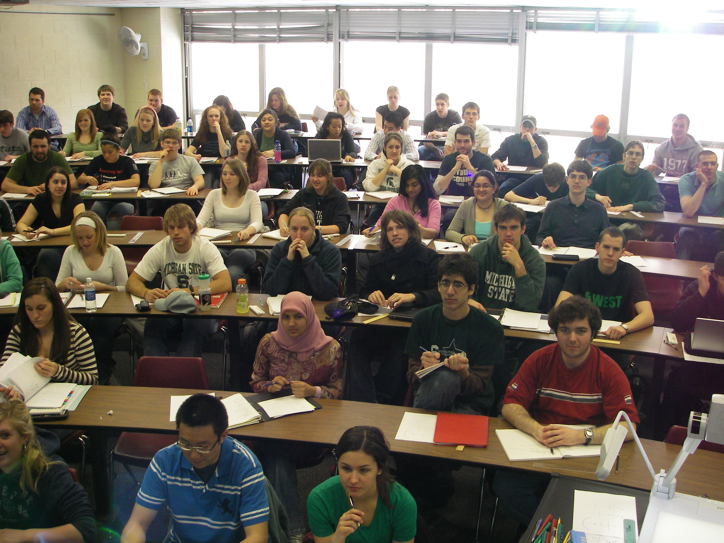
Clickers
That’s clear – no, wait …
Doesn’t he get that we don’t get it?
Yawn!
Looks like everybody but me understands this!
I wonder what’s for lunch

Slide 13
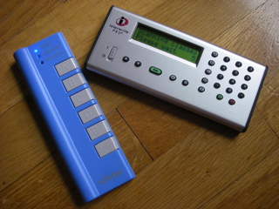
Clickers
RF devices
One per student
Students can answer questions during lecture

Slide 14
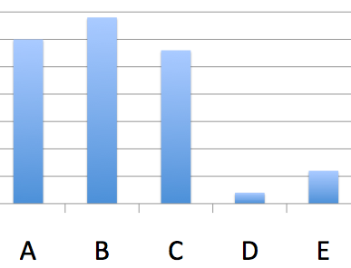
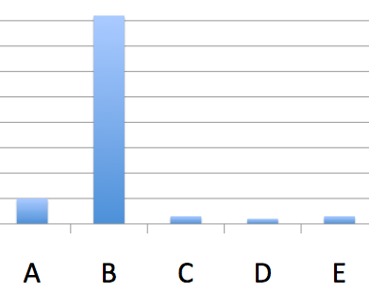
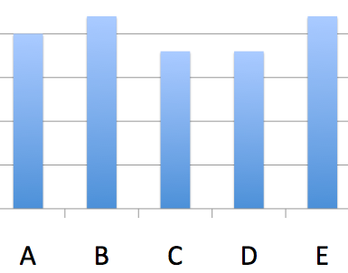
Clicker
Lecture progress depends on voting outcome
  Explain again
  Go on
  Let students discuss
  and vote again

Slide 15
Clicker
Peer-Instruction
Students can sometimes explain concepts better than us to their peers
  We have forgotten what we initially struggled with
Students learn while explaining

Slide 16
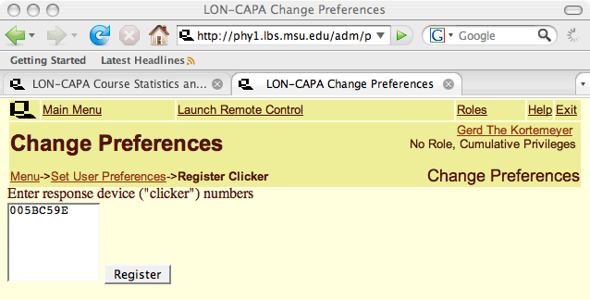
Clicker
Students register in LON-CAPA

Slide 17
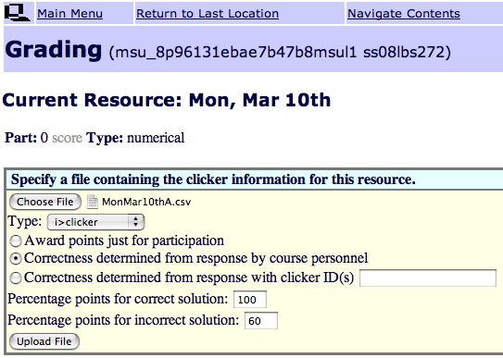
Clicker
Give credit for correct and for incorrect answers

Slide 18
Post-Class Questions
Homework
Helprooms
Exams

Slide 19
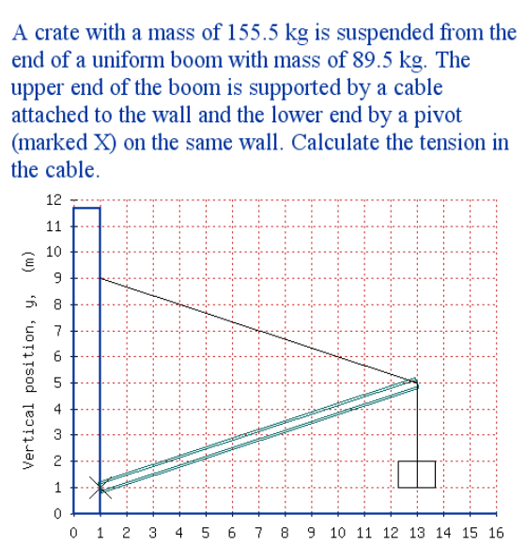
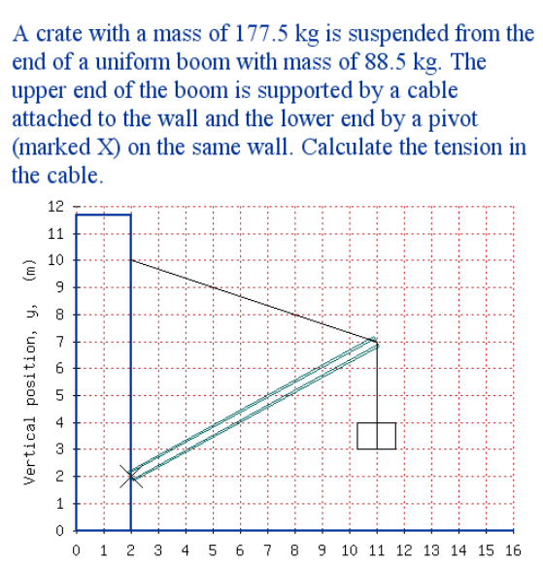
Homework
More sophisticated highly randomizing problems

Slide 20
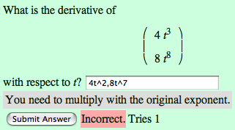
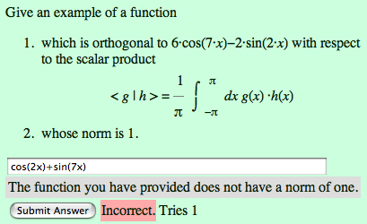
Homework
…special emphasis on math
  including support of
    LaTeX
    Maxima
    R

Slide 21
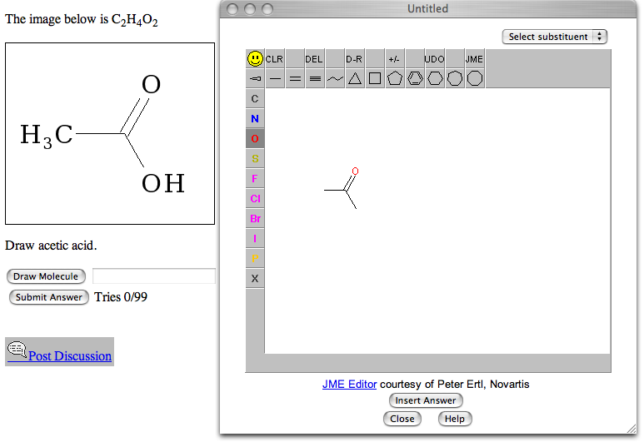
Homework
… chemistry …

Slide 22
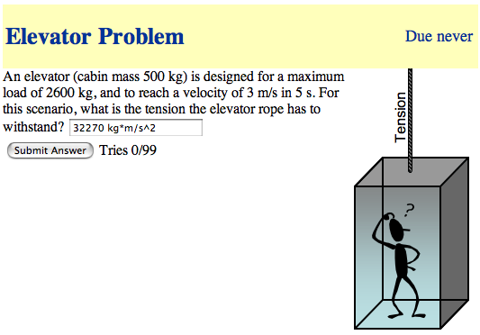
Homework
… physical units …

Slide 23
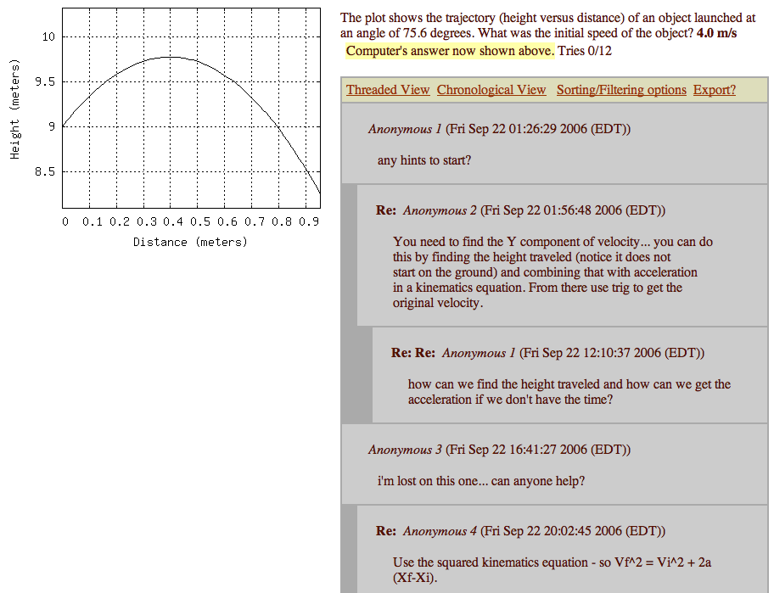
Online Discussions
Discussions
Encouraged, since all students have different versions.
Again: Peer-Instruction.

Slide 24
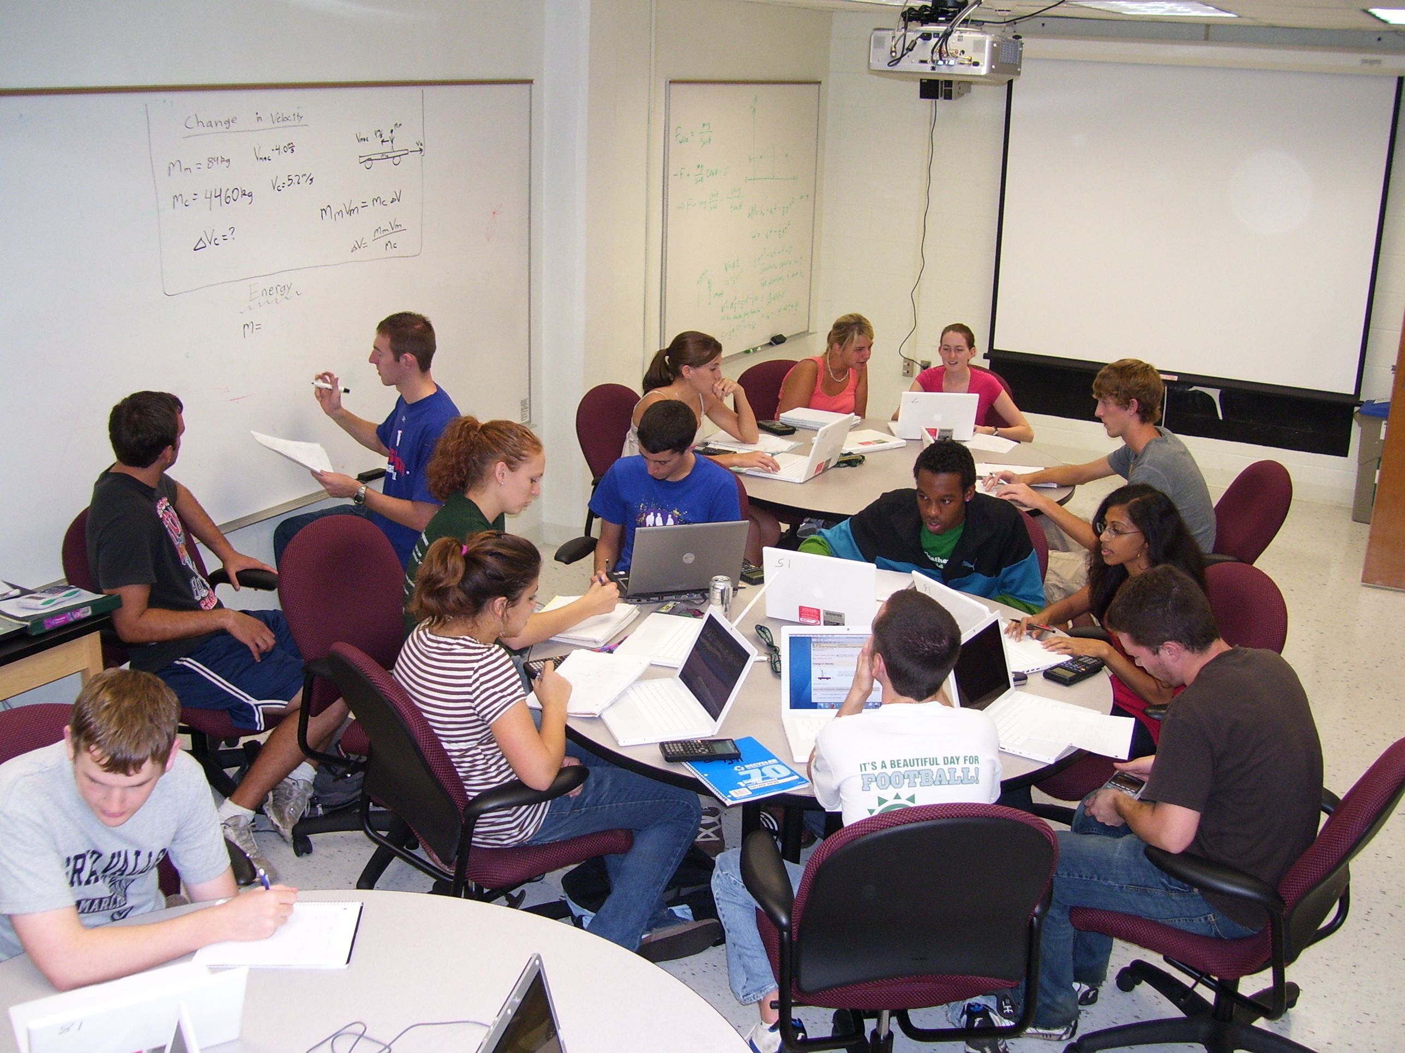
Helprooms
Staffed
with
Learning
Assistants
in the
evenings
Collaborative learning space, peer instruction

Slide 25
Exams
Problems can also be rendered for bubble sheets
Each student has a different exam

Slide 26
Before we go on …
… does this even work?

Slide 27
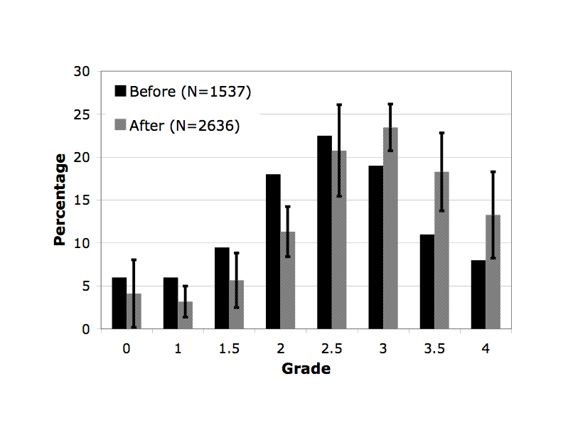
Learning Success
Intro Physics for Scientists and Engineers
Grades in years before and after online homework

Slide 28
Learning Success
Mostly helps students who are on the brink of failing the course.
Here at Purdue:
“Signals”
Fail

Slide 29
How is this realistically possible?

Slide 30
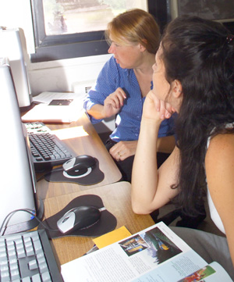
Sharing of Resources
Creating online resources is a lot of work
Doing so for use in just one course is a waste of time and effort
Many resources could be used among a number of courses and across institutions

Slide 31


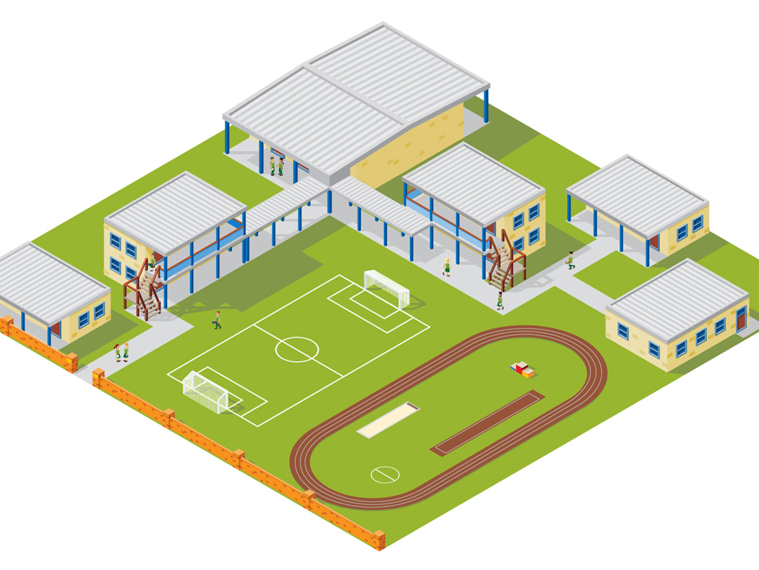



LON-CAPA Architecture
WWW
Web
Instructor
Computer
Interserver
Campus A
Campus B
WWW
Campus C
Inter-Institutional
Network of Servers Connecting Universities and Schools
Student Computer

Slide 32










LON-CAPA Architecture
Campus A
Campus B
Course Management
Course Management
Resource Assembly
Resource Assembly
Shared Cross-Institutional Resource Library

Slide 33
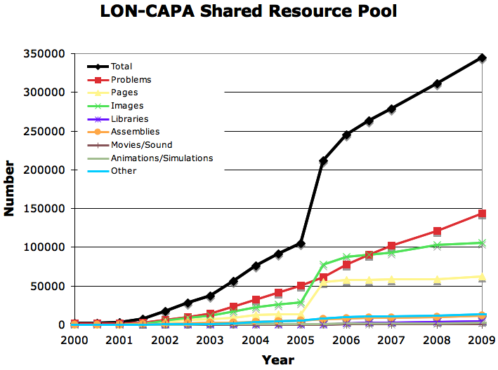
The LON-CAPA Community
Shared content repository with almost 350,000 resources
Almost 150,000 online homework problems

Slide 34
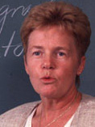



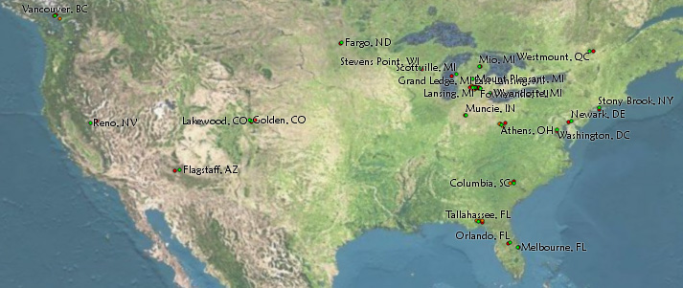



Resource Assembly
Writes module about
energy conservation
Compiles module about conservation laws
Writes module about
momentum
conservation
Uses whole
assembly
in his course

Slide 35

The LON-CAPA Community
High Schools, Colleges, and Universities
Canada: 6
Germany: 3
Turkey: 1
South Korea: 1
USA: 106
Switzerland: 1
Israel: 2
Brazil: 1
South Africa: 1
… plus grant projects and publishing companies.

Slide 36
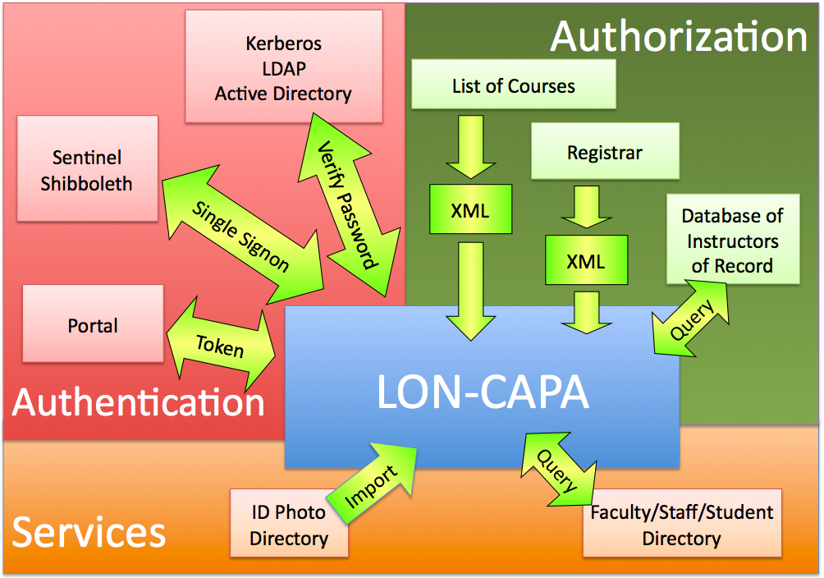
Think Global, Act Local

Slide 37

Let’s do some authoring!

Slide 38
Thank you!
Gerd Kortemeyer
korte@lite.msu.edu
http://www.lon-capa.org/

